Slide 1
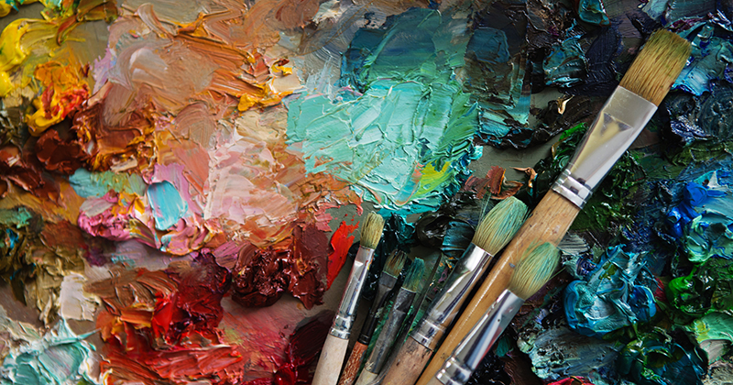
Art GCSE Exam Support Pack
Name:
Target Grade:
Exam Question number:
Useful Sources of Support
YouTube/Google – look up exemplar GCSE sketchbooks & exam projects.
Explore the GCSE sketchbook exemplars available within the department.
For a challenge, look at the A Level exemplar books provided within the department.
Look at the AQA standardisation examples to check your work against the exam board standard and see ways to improve.

Slide 2
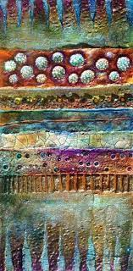
Exam Dates and Times
Exam dates and times:
Week beginning 20th April – bring your sketchbook in for first session and then it must remain in the exam room until all sessions are complete.
You will be given an individual timetable for your sessions.
You will not be allowed to start your exam sessions unless you have your sketchbook and all your preparatory work with you.

Slide 3
Extra Support Sessions Art GCSE Exam Preparation.
Open house lunchtimes
E29 is open at lunchtimes Monday to Thursday for Year 11 to access materials, computers and a space to work & eat a packed lunch.
After School Sessions
An exam prep session is open every Monday from 3.15 p.m. – 4.15p.m. Students are free to come to as many as these as they want but need to book in.
Equipment and Resources
If you need to borrow any equipment and resources, this may be possible, come and talk to me ☺

Slide 4
Framework for analysis
Content
What can you see in the picture? Think about objects, colours, shapes and textures.
Can you see anything unusual?
Are any of the objects symbolic (do they have a hidden meaning?) Is the artwork about something or someone, or both?
Form
What is the artwork made from?
What styles or skills can you see?
Is there a colour scheme?
What is the composition (layout) of the work?
Where is the main focal point, and why do you think this is?
Are there any textures, shapes, patterns in the artwork?
Mood
What is the atmosphere or general feeling of the artwork?
What does it make you think about?
Does it make you feel any emotion: happy, sad, strange, interested, inspired?
Does the artwork have a long lasting impact on you, or is it easily forgettable?
Process
How was the artwork made?
What was the process and what tools or materials did they use?
Do you think the artist made any other versions or sketches?
What did the artist look at to make this piece/what were they inspired by?
What was happening at the time the artwork was made – in society or the artist’s personal life?
Context
What is the art movement that this piece/artist belongs to? What are there main ideas?

Slide 5

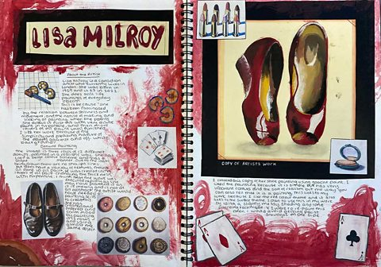
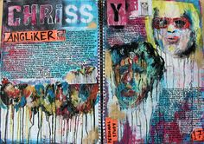
ART AO1 – What have I learned from my artist(s)?
Introductory page:
Write out your chosen exam start point on the first page of your exam unit.
Make a brainstorm about your initial thoughts and ideas.
Write two sentences about why you have chosen your initial artist(s) – what is it you like about them and how do they fit the theme.
Mark out of 24
Task List
Choose at least one artist who is internationally known. Check them with your teacher.
Print and stick in an image collection of at least 10 pieces of their work.
List the key elements of their style.
Complete analysis on your artist(s) following the framework – always give drafts to your teacher to check before you stick in the final draft.

Slide 6
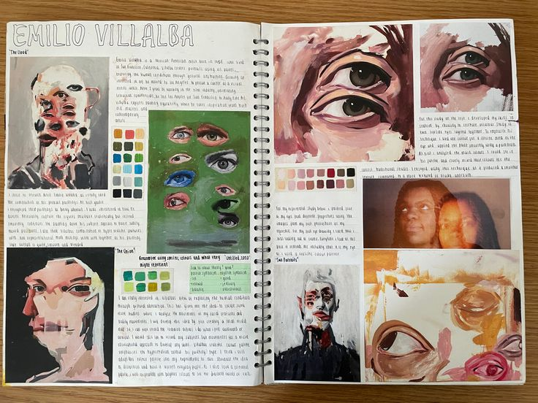
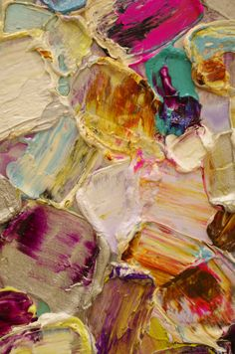
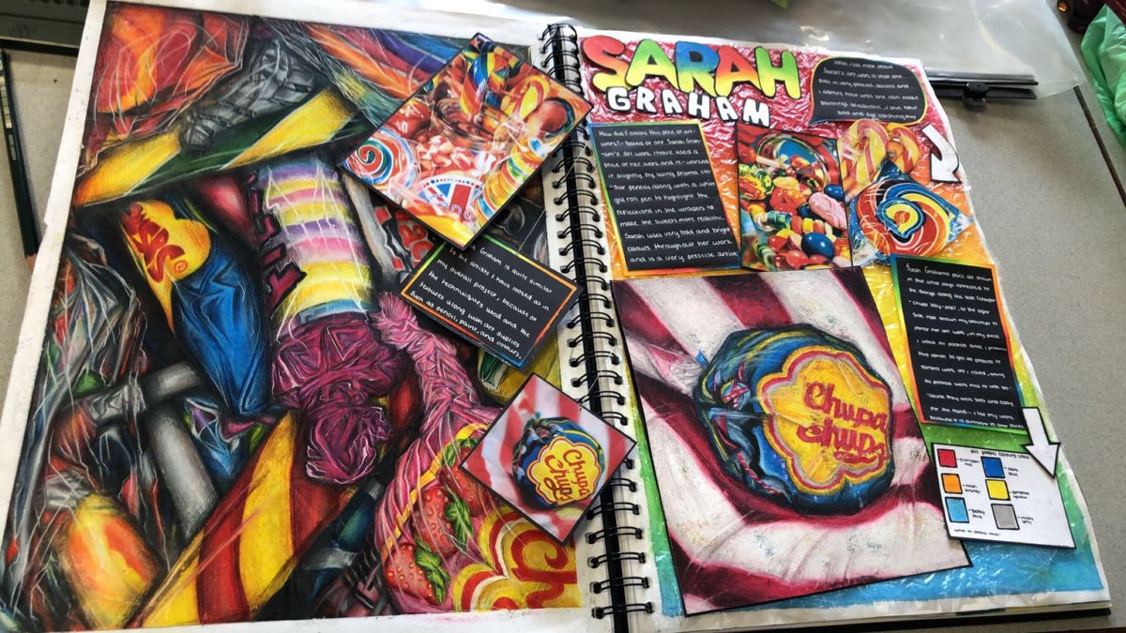
ART AO2 – What am I planning to do in my final piece?
Task List
Collect and present reference images that you will work from for your ideas.
Sketch out a page full of quick ideas and annotate with how you would make them, and how they relate to your artist(s).
Sketch out your chosen idea and annotate in more detail.
Stick in any further reference images used.
Stick in any photographs you have taken to support your ideas development.
Try out colour schemes for your final idea.
Try out different media for your final idea and annotate with which you will use and why.
Write up any techniques you are using.
If you have though of a way to improve your idea, sketch out your new final plan and annotate with how it has changed and why.
Mark out of 24

Slide 7
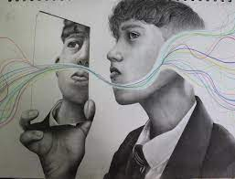
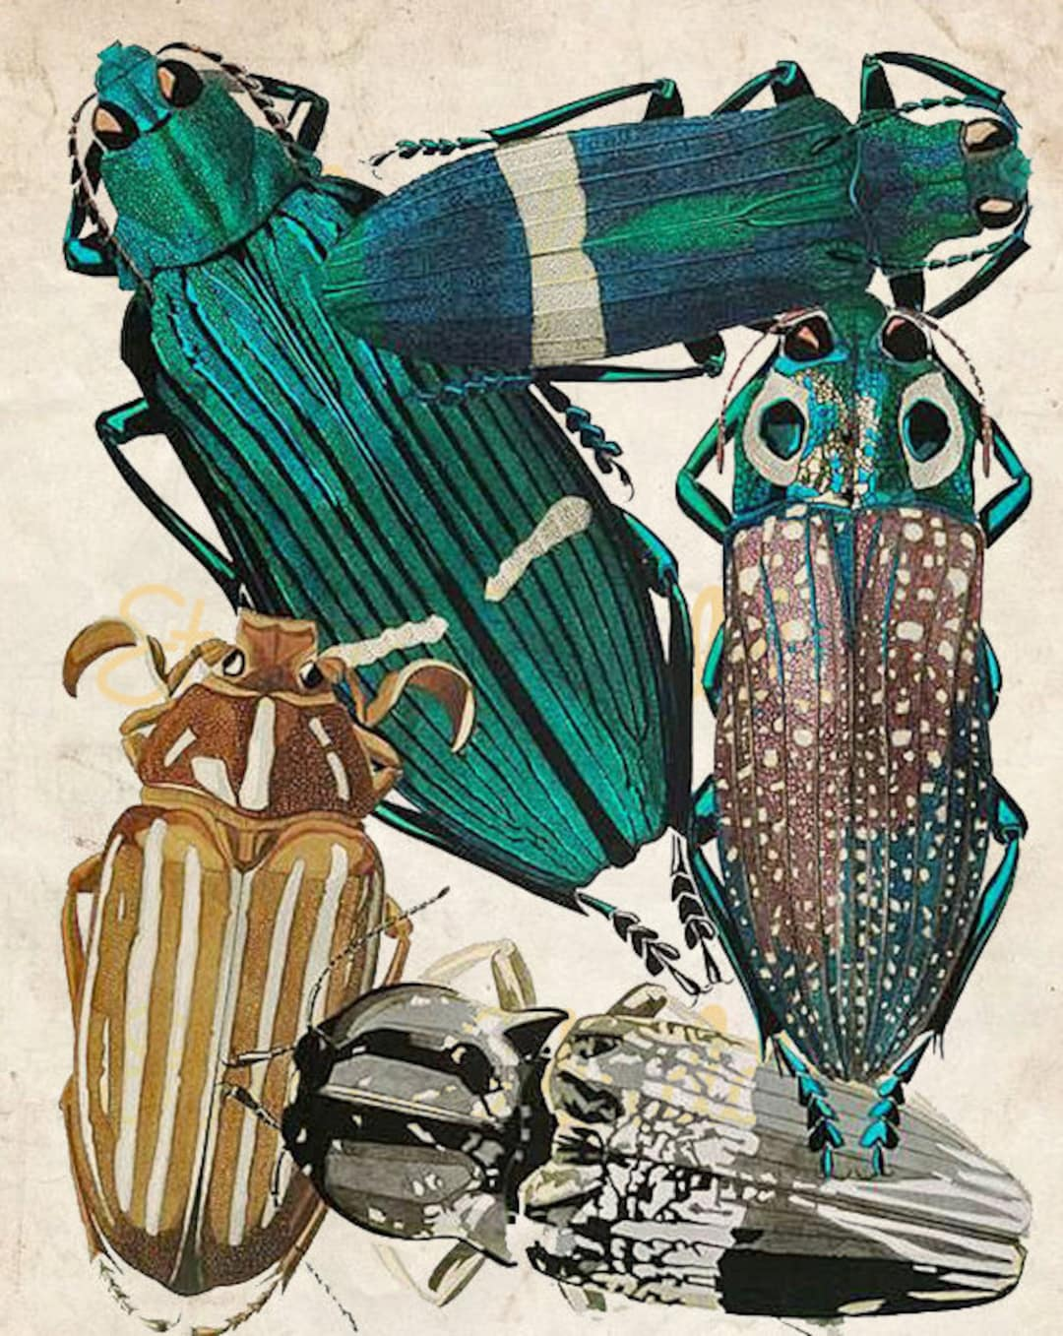
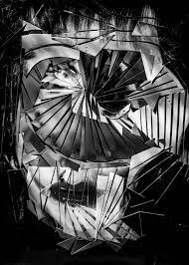
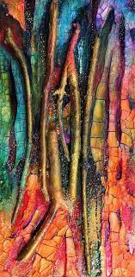
Work Smart – remember all prep and exam work is marked holistically. If you don’t develop ideas/link to artists, you are lowering all assessment objectives. If you copy styles and imitate, rather than synthesize and create, you are limiting your potential grade.
If you make your experiments technically skilled they will raise AO3 as well as AO2. If they show understanding of relevant artists, they will raise AO1.

Slide 8
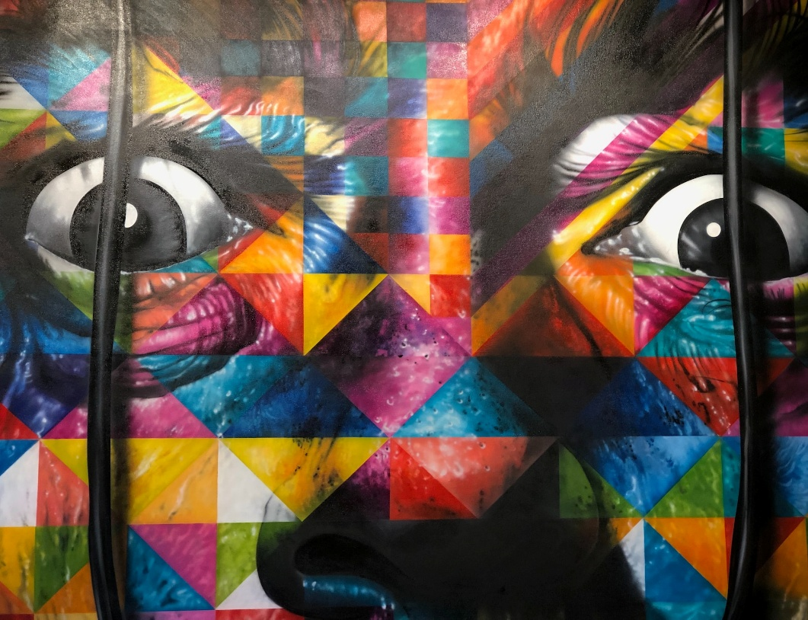
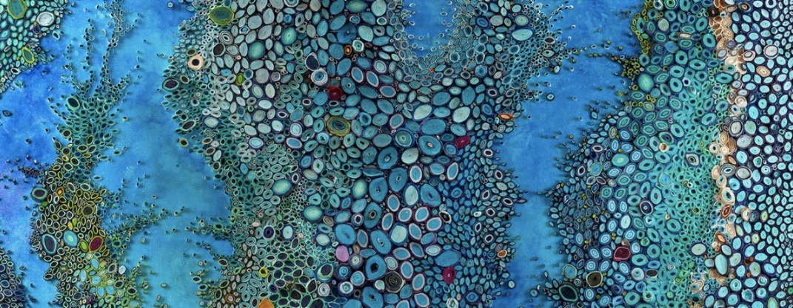
ART AO3 – Technical skill in practical and written work.
Mark out of 24
Task List
Make at least 2 artist’s studies focusing on accuracy and presented alongside the image you are working from.
Make at least 3 drawings from reference images that are relevant to your theme and present alongside the reference image you are working from.
Create at least 2 skilled sketches of your potential final piece.
If it is relevant, take photographs to support your prep work and label them as your own.
Draft and re-draft writing putting P4P into action to raise the technical skill in your writing.
Make sure that the way you present your book shows technical & visual skills.

Slide 9
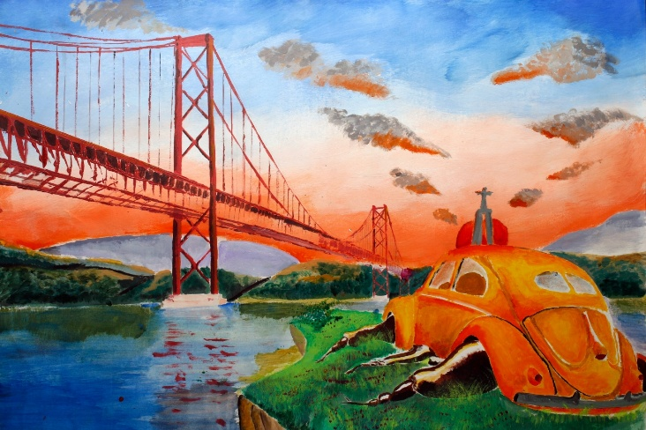
ART AO4 – What will I create in the exam on my final piece(s)?
This is your task list to fill in with the stages you will go through with your final piece(s) and approximate timings for each stage.
You need to make sure your final piece links to your preparatory work and theme, and that it shows learning from your artists and technical skill.
Remember! You need to bring in all the things that you need at the start of the exam including your sketchbook and any images/materials you will use. Once the exam starts you can’t bring in anything else.
Exam Time Plan Example
Paper stretched before exam – check it has worked the week before
1 hour drawing out design
2 hours adding base layers of colour
7 hours adding on detail, focal areas first
Possible solutions for issues with time – Make sure I’m using tonal contrast in initial layers
Pre make some elements of design and just evidence this
Pre draw out design if it is very complex and just evidence this
Mark out of 24

Slide 10
Assessment Objectives | How will I achieve a grade 7 to 9? | What extra tasks can I complete that will help boost my grade?
AO1 – What have I learned from my artist(s) | Have you referenced relevant artist(s)? Are at least some of your chosen artists’ well known enough to be written about in books? | Make links between your artist and others who work in a similar way, on a similar theme in a different way. Collect images, brainstorm and write about them in your analysis. Visit relevant galleries that are showing work by your artist or other artists who work in a similar way/on a similar theme. Collect postcards, photographs of work and yourself at the gallery. Take notes on the work from looking at it first hand. This will help raise your grade.
AO2 – How effective is the development and refinement of my ideas? | Is your idea sophisticated? Does it link to your artist(s) but take their ideas onwards in a new way? Does it develop and refine, trying out different versions and getting better? Are your media experiments successful? Do you make intelligent decisions? Does your sketchbook evidence the complexity of your thinking? | You could keep a log of your thinking processes, a bit like a diary of an explorer charting new lands. Analyse what you are attempting, why you are attempting it linking to artists. Evaluate whether it is successful or not as you progress, and what you intend to do about it.
AO3 – How good are my technical skills? | Do you have a good volume of work? Does it show a high level of detail in line with the artist(s) you have studied? Detail could be line, tone, colour detail depending on what kind of artists you are using. This AO is also marked through your final piece, does your piece show the same level of detail as your preparatory work? | Volume is everything for this AO at the required standard, you could complete extra drawings, paintings and add them into your project.
AO4 – How well does my final piece realise my planning, how technically skilled is it, how much learning from my artist(s) does it show? | Have you done what you intended and is it a personal response? Is it technically skilled? Is your idea linked to artists and yet your individual interpretation? Does it look good?! Is it finished? | Make sure before you start the exam that you have a great plan and have tried out all of the materials you intend to use. Make a time plan for the full 10 hours.

Slide 11
ART AO4 – How will I use my exam time effectively? This page is for you to complete your exam plan.
Exam Time Plan

